Slide 1
Document Object Model

Slide 2
Objective
Understand the JavaScript Object Model
Understand the Window object, Frame and Navigator Object
Working with Location and History Object

Slide 3
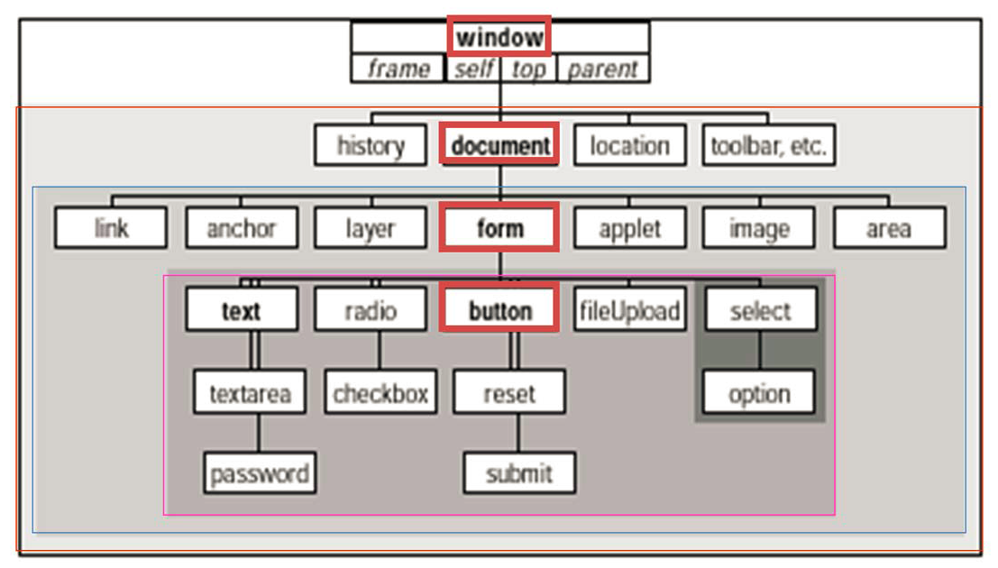
JavaScript Document Object Model

Slide 4
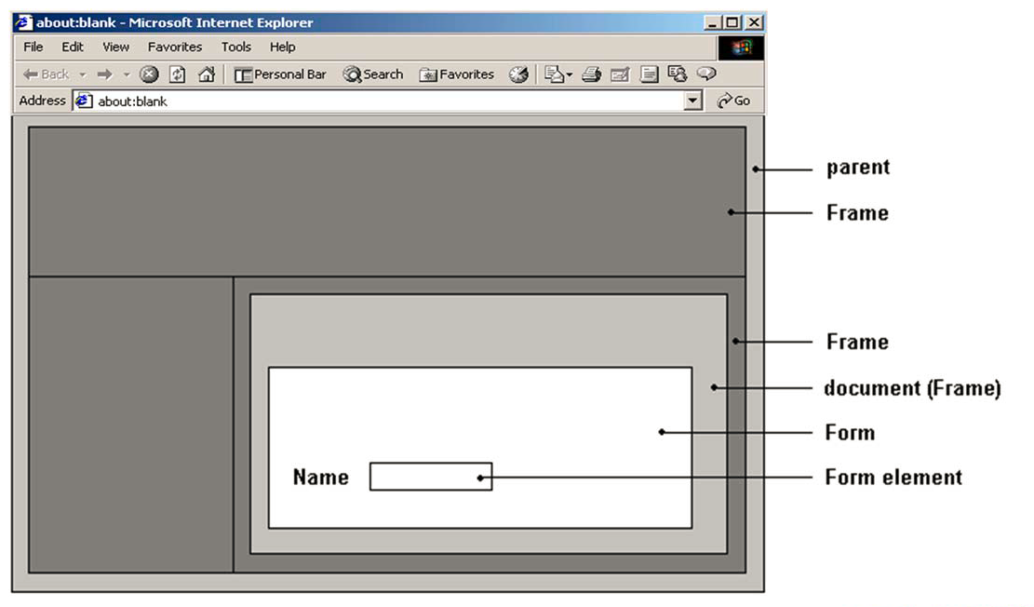
JavaScript Document Object Model

Slide 5
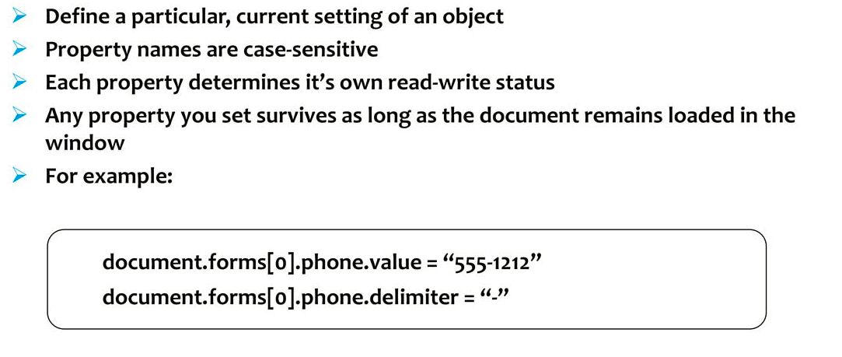
Object Properties

Slide 6
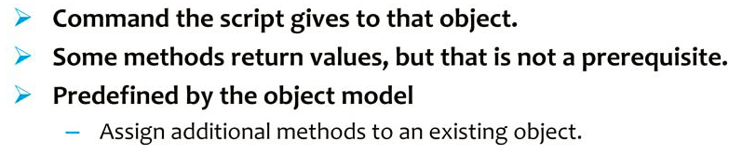
Object Methods

Slide 7
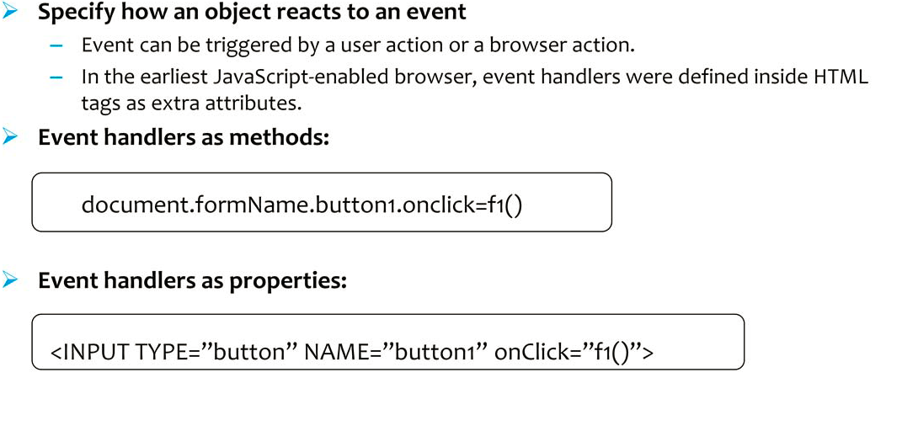
Event Handlers

Slide 8
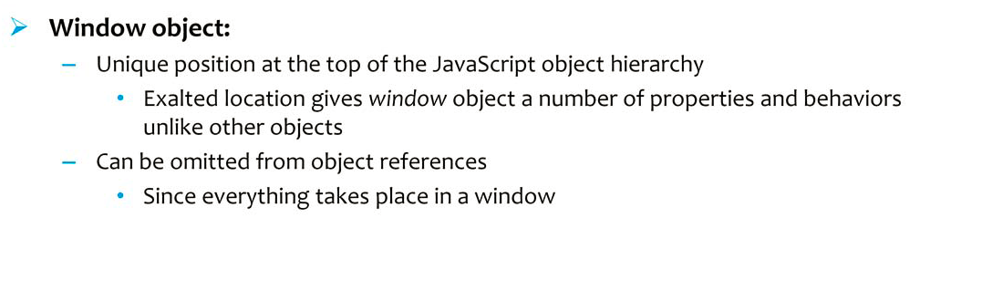
Working with Window Object

Slide 9
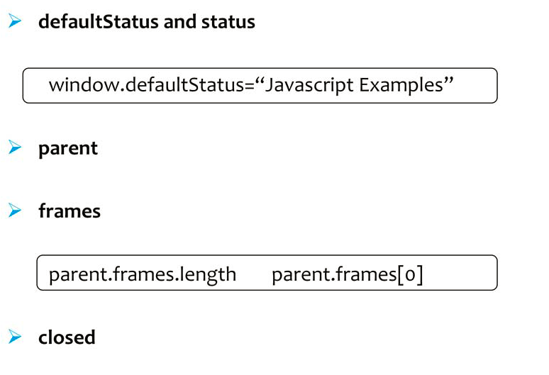
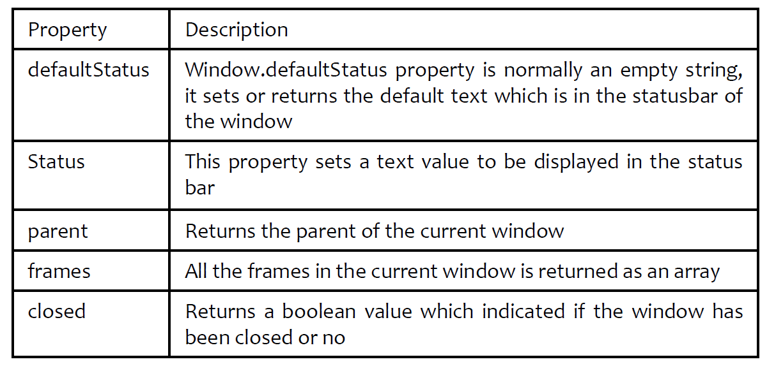
Window Object Properties

Slide 10
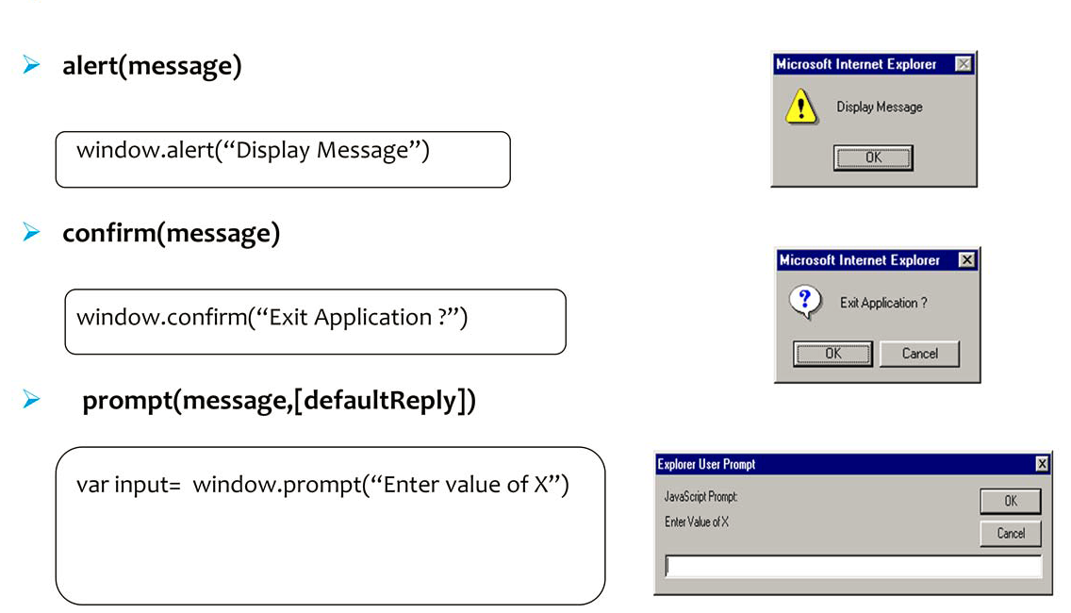
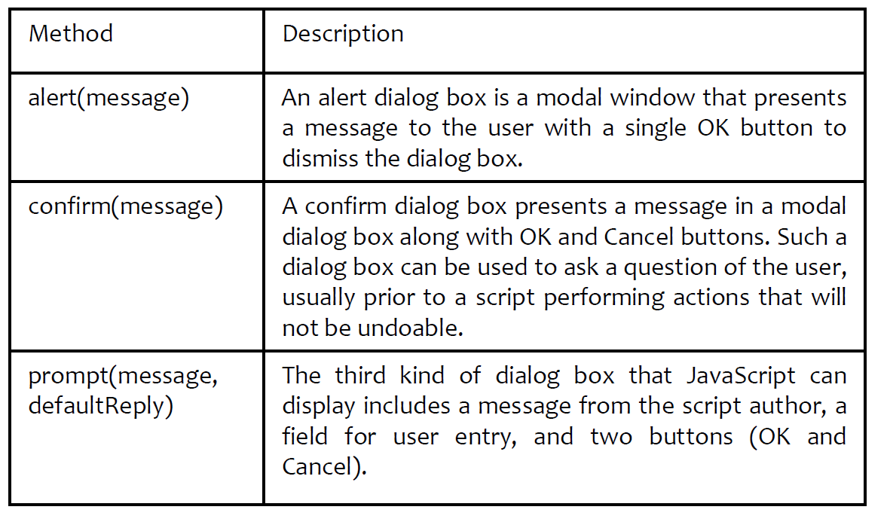
Window Object Methods

Slide 11
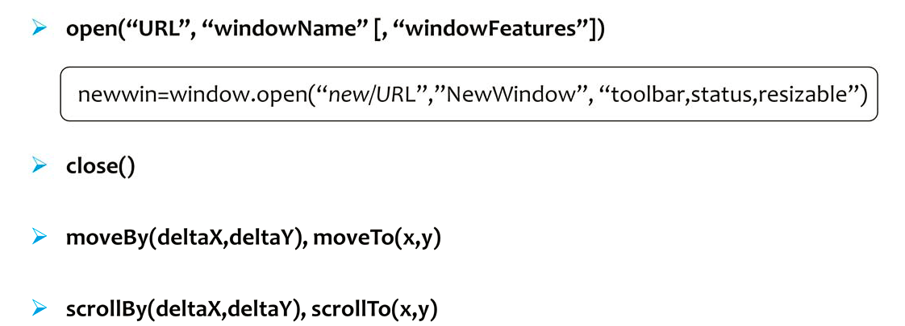
Window Object Methods

Slide 12
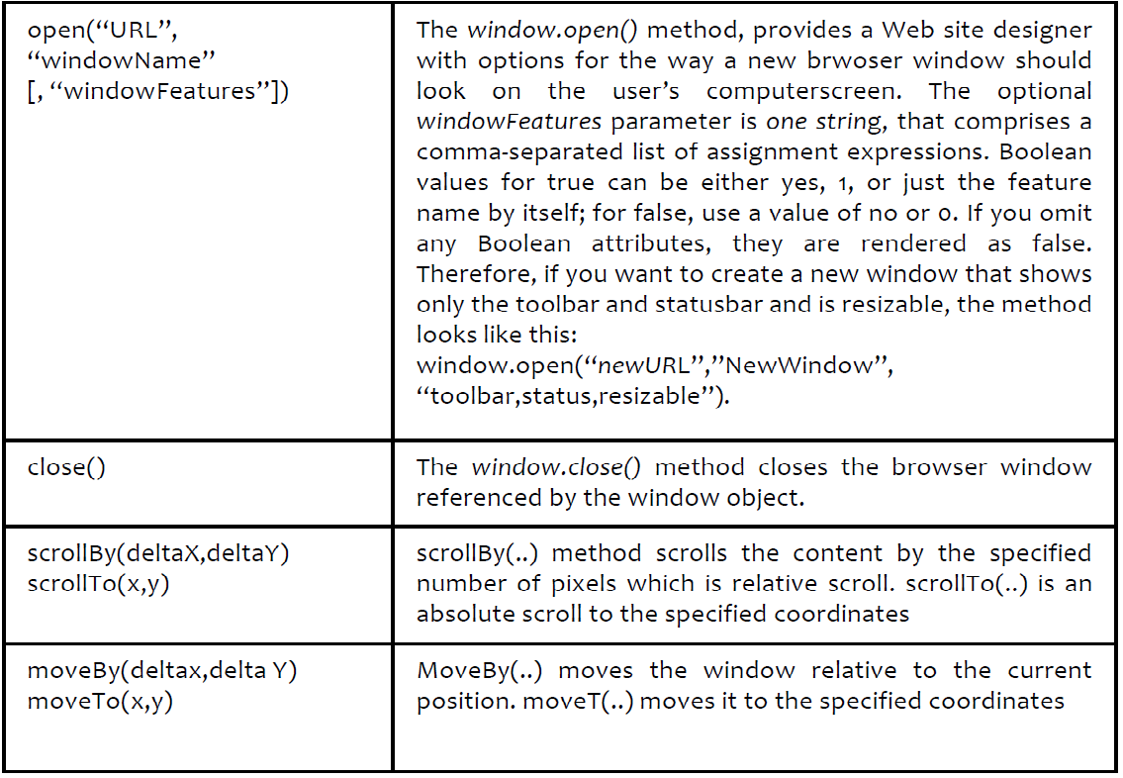
Window Object Methods

Slide 13
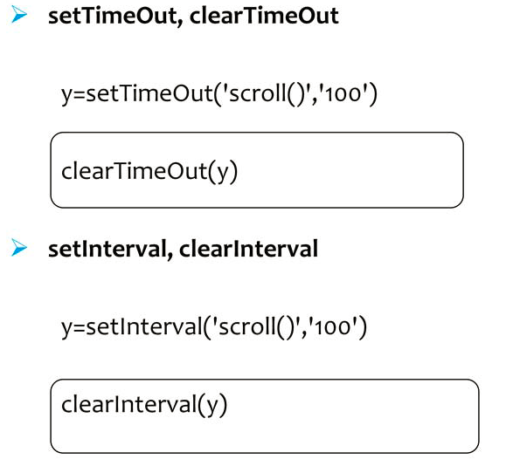
Window Object Methods

Slide 14
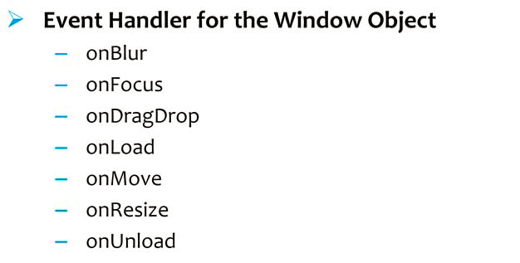
Window Object Event Handlers

Slide 15
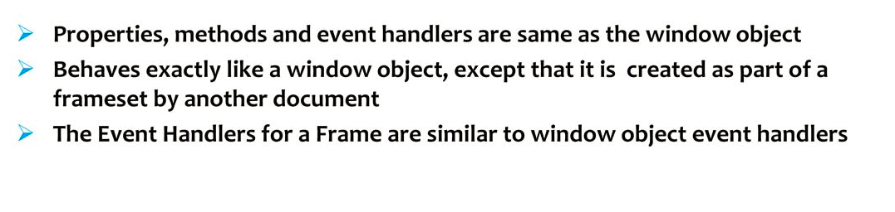
Frame Object

Slide 16
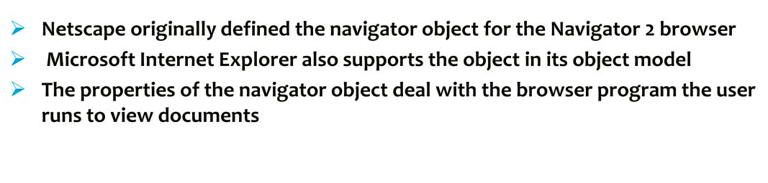
Navigator Object

Slide 17
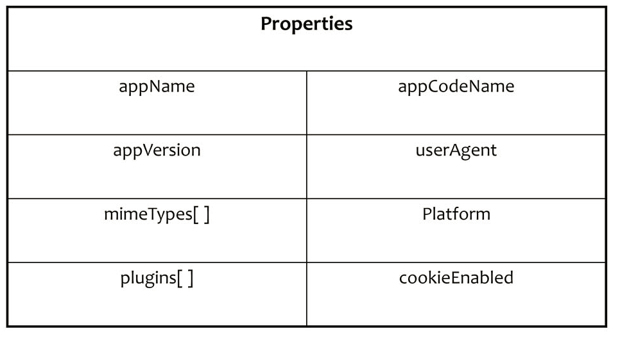
Navigator Object

Slide 18
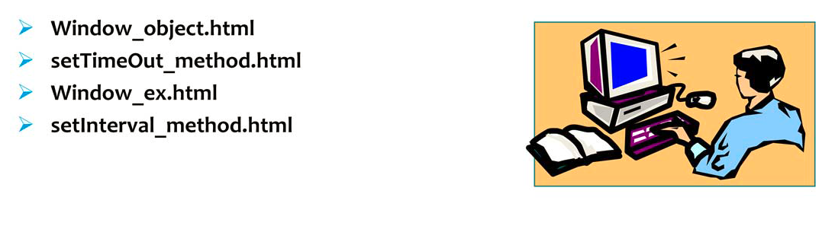
Demo

Slide 19
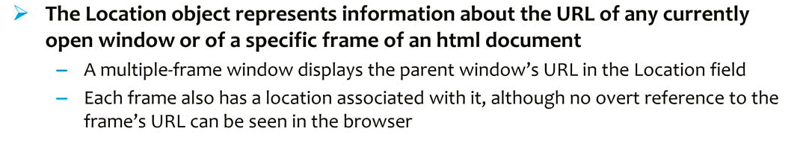
Rationale of Location Object

Slide 20
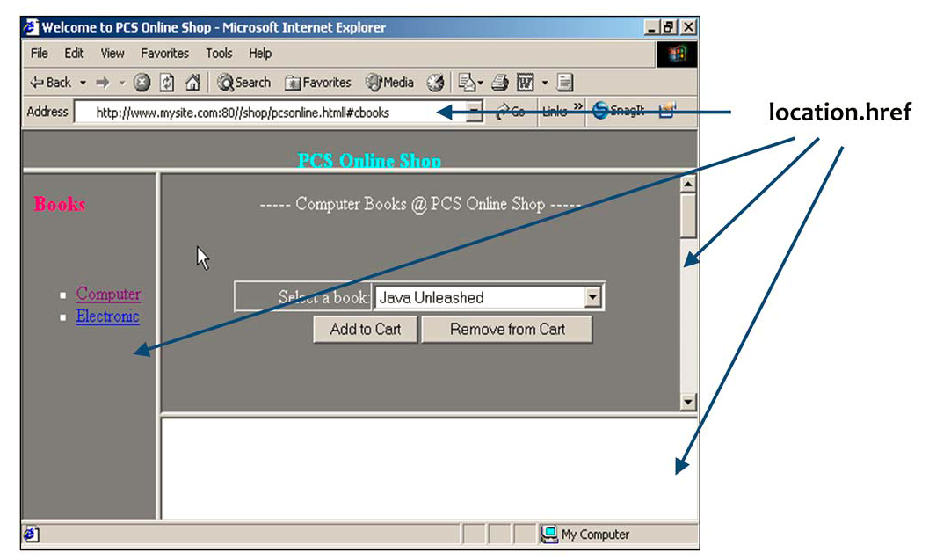
Rationale of Location Object

Slide 21
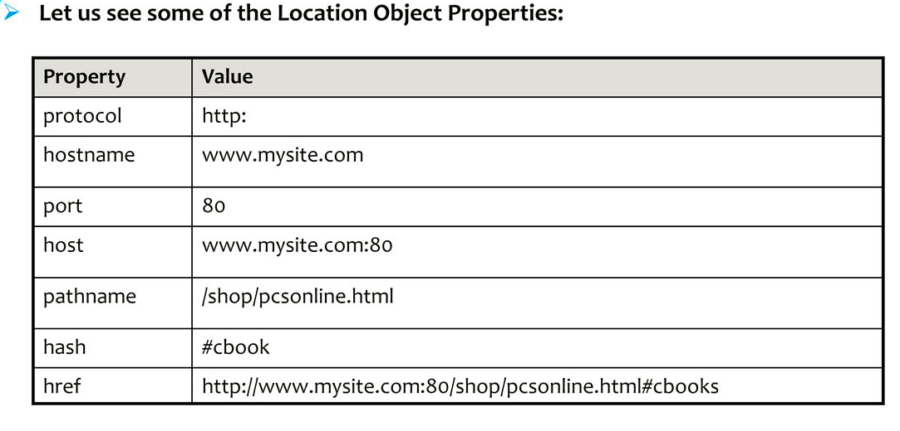
Location of Object Properties

Slide 22
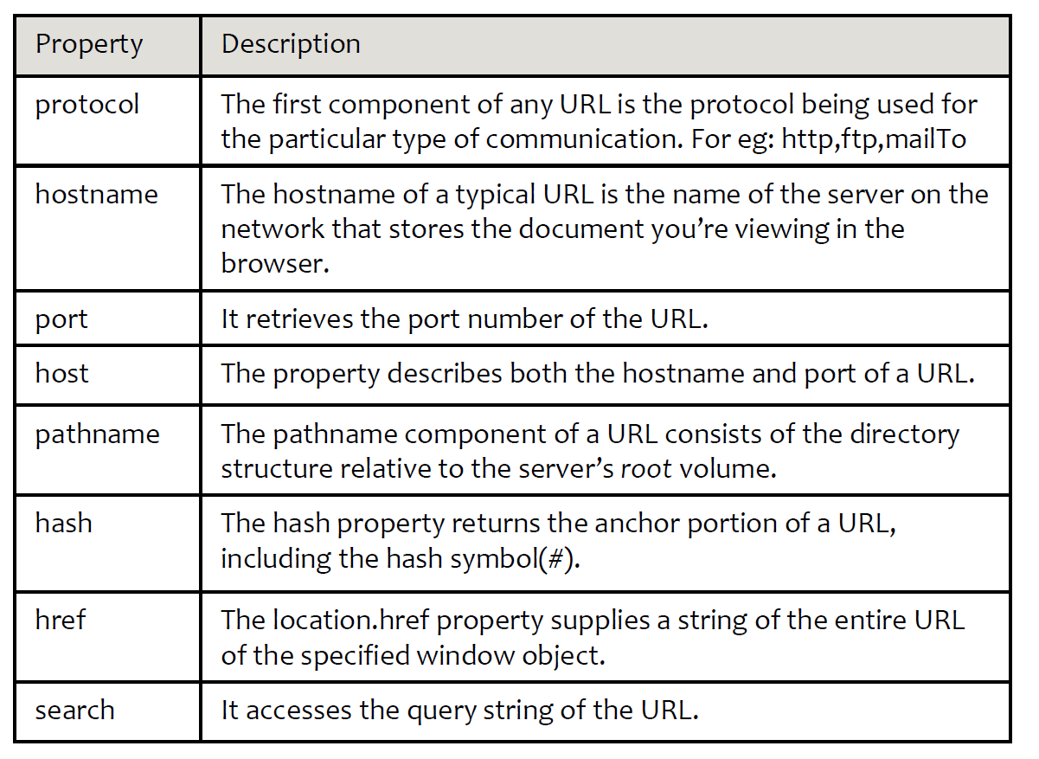
Location of Object Properties

Slide 23
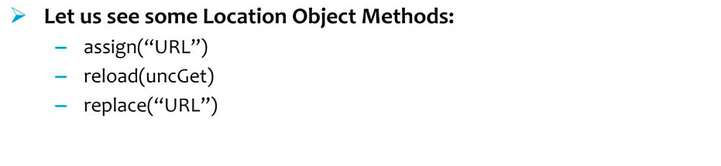
Location Object Methods

Slide 24
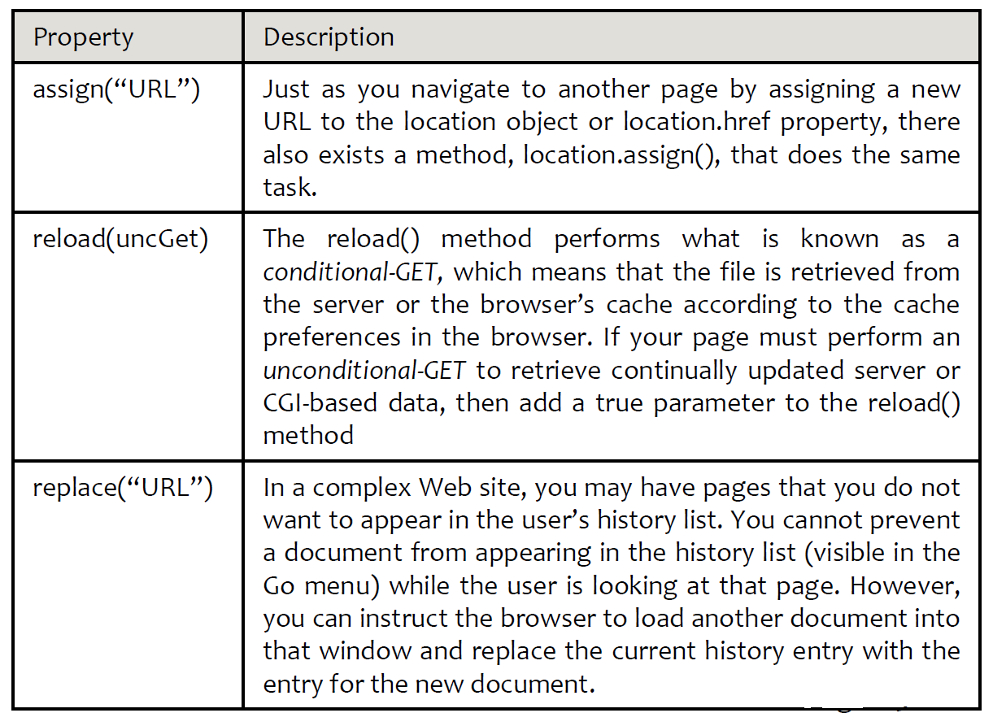
Location Object Methods

Slide 25
Rationale of History Object

Slide 26
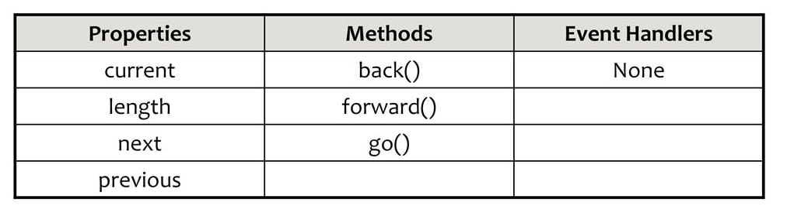
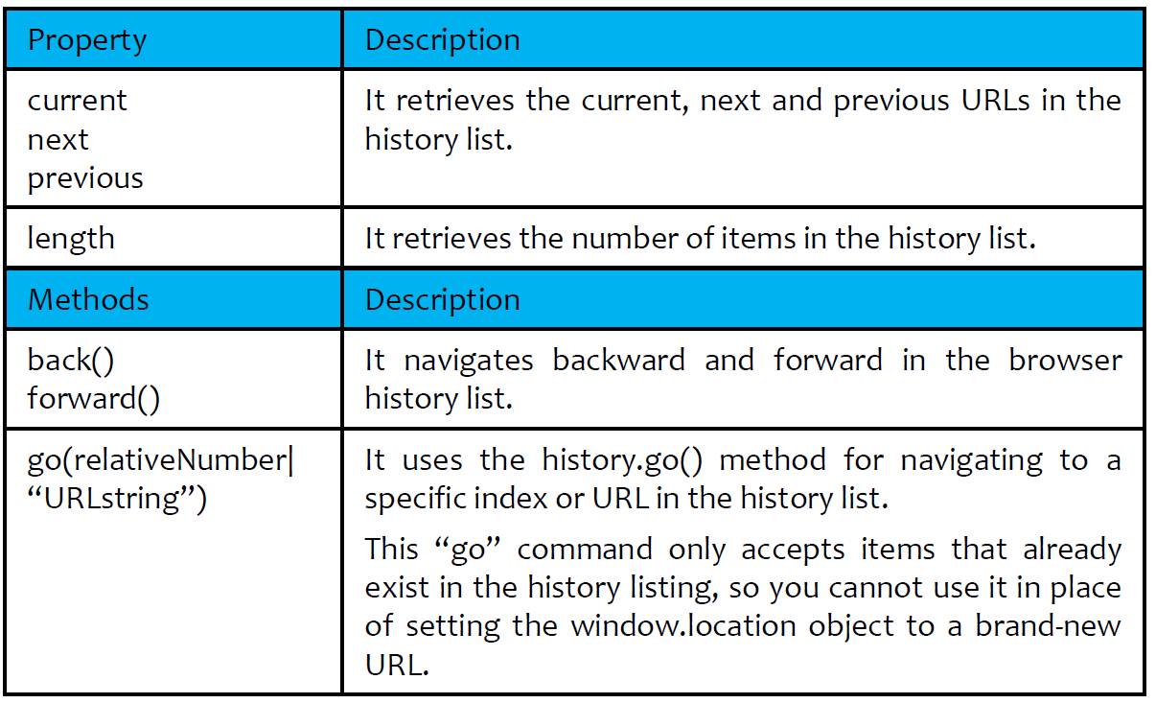
History Object Properties

